Slide 1



AGE 214: Lecture 7
Diode Applications III: Clippers & Clampers
Sokoine University of Agriculture
AGE 214 - Lecture 7

Slide 2


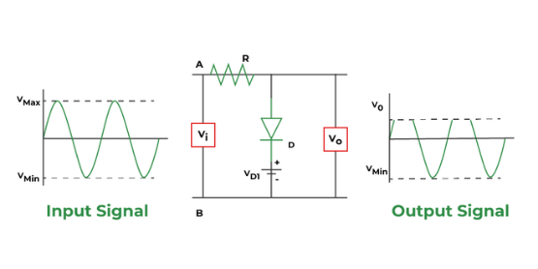
Clipper Circuits
Definition
A circuit that removes ("clips") a portion of an input signal without distorting the remaining part.
Also known as Limiters.
Uses
•
Protection of circuits from high voltage spikes.
•
Waveform shaping (Sine to Square wave).
Sokoine University of Agriculture
AGE 214 - Lecture 7

Slide 3

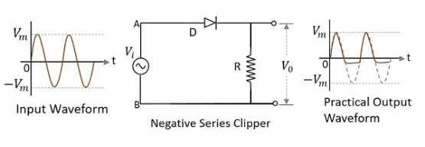
Series Clipper
Operation
•
Diode is in series with the load.
•
Negative Series Clipper:
○
Positive Half: Diode is ON. Output follows Input.
○
Negative Half: Diode is OFF. Output is Zero.
•
It "clips off" the negative cycle (Similar to Half-Wave Rectifier).
Sokoine University of Agriculture
AGE 214 - Lecture 7

Slide 4
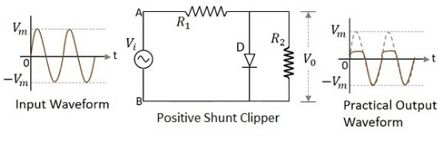
Shunt Clipper
Operation
•
Diode is in Parallel with the load.
•
Positive Shunt Clipper:
○
Positive Half: Diode ON (Short Circuit). Output = 0V (approx).
○
Negative Half: Diode OFF (Open Circuit). Output = Input.
Sokoine University of Agriculture
AGE 214 - Lecture 7

Slide 5
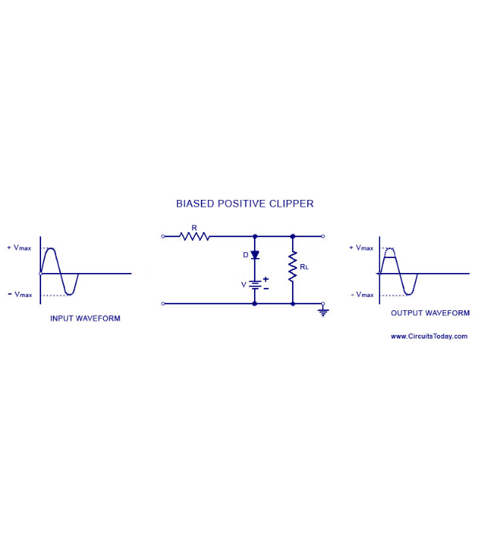
Biased Clippers
What if we want to clip at +3V instead of 0V?
•
We add a DC battery (V_{bias}) in series with the diode.
•
Rule: The diode will not conduct until the input voltage exceeds V_{bias} + 0.7V.
•
This allows precise control of the clipping level.

Slide 6
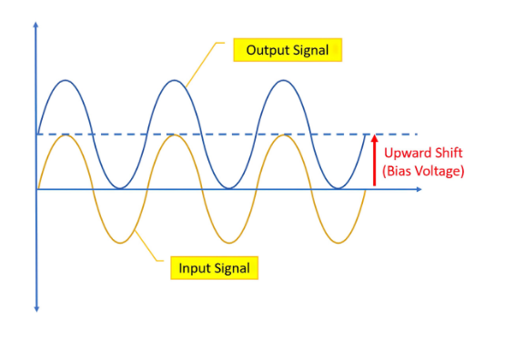
Clamper Circuits
Definition
A circuit that shifts the entire signal up or down to a different DC level without changing its shape.
Also known as DC Restorers.
Components
•
Diode
•
Capacitor
•
Resistor
Sokoine University of Agriculture
AGE 214 - Lecture 7

Slide 7





How Clamping Works
1. Charging
2. Summing
3. Result
During the first cycle, the diode conducts and charges the Capacitor to the peak voltage (V_{m}).
The Capacitor acts like a battery. The Output = Input + Capacitor Voltage.
The whole waveform is shifted by V_{m}.
Sokoine University of Agriculture
AGE 214 - Lecture 7

Slide 8
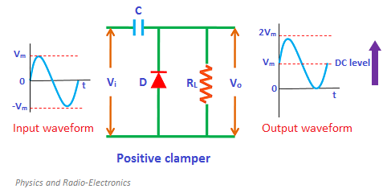
Positive Clamper
Shifting Up
•
Shifts the signal upwards so the negative peak sits at 0V.
•
Configuration: Diode points UP (Cathode to ground).
•
Output swings from 0V to 2V_{m}.
Sokoine University of Agriculture
AGE 214 - Lecture 7

Slide 9
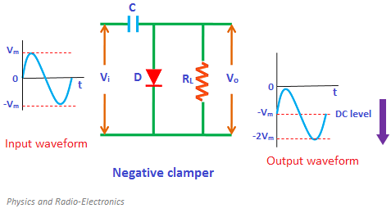
Negative Clamper
Shifting Down
•
Shifts the signal downwards so the positive peak sits at 0V.
•
Configuration: Diode points DOWN (Anode to ground).
•
Output swings from 0V to -2V_{m}.
Sokoine University of Agriculture
AGE 214 - Lecture 7

Slide 10
Summary
Circuit | Function | Key Components
Clipper | Removes part of signal | Diode + Resistor (+ Battery)
Clamper | Shifts DC level | Diode + Resistor + Capacitor
Rectifier | AC to DC | Diode (+ Transformer)
Sokoine University of Agriculture
AGE 214 - Lecture 7

Slide 11
Questions?
Next Lecture: Bipolar Junction Transistors (BJT)
Dr. Kadeghe Fue
Sokoine University of Agriculture
AGE 214 - Lecture 7

